Slide 1
ASSIGNMENT #2
Measures of Dispersion

Slide 2
Group Members
Ahmed Ali (B20102013)
Annas Baig (B20102078)
Muhammad Amas Waseem (B20102077)
Muneeb Adil (B20102125)
Subhan Ahmed (B20102148)
Syed Zawwar Ahmed (B20102173)
Tayyab Ayub (B20102178)
Zunain Ali Azam (B20102183)

Slide 3
Range
Compute the range of the following data

Slide 4
Function
function [Range] = ungrouped_range(R)
Xm = max(R); % Maximum Range
Xi = min(R); % Minimum Range
Range = Xm-Xi;
end

Slide 5
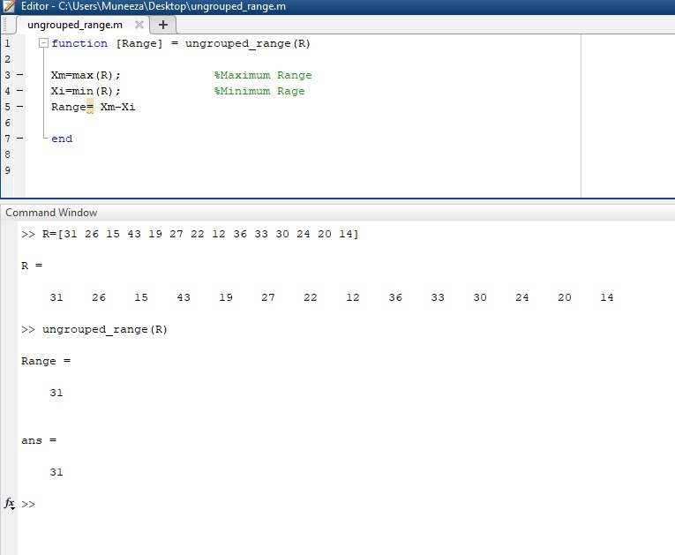
Output of Range (UG)

Slide 6
Grouped Range
Compute the range of the following data

Slide 7
Grouped Function
function [Range] = Grouped_Range(U, L)
If (U(1)~=L(1+1))
U = U+0.5; % Upper class boundary
L = L-0.5; % Lower class boundary
end
Xm = max(U); % Maximum Range
Xi = min(L); %Minimum range
Range = Xm-Xi;
end

Slide 8
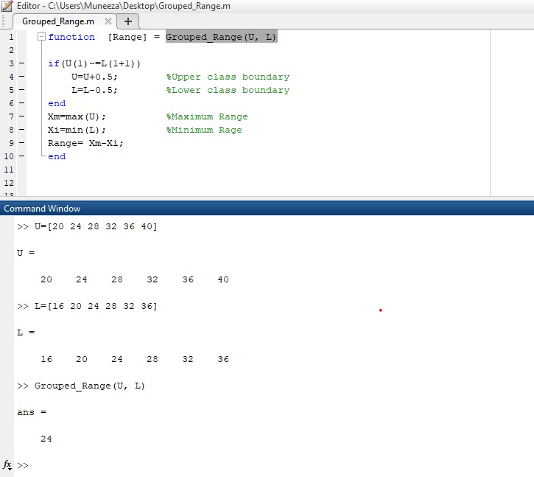
Output of Grouped Range

Slide 9
Coefficient of Range
Compute the Coefficient range of the following data

Slide 10
Function
function [coff_of_Range] = coeff_ungrouped_range(R)
Xm = max(R); % Maximum Range
Xi = min(R); % Minimum Range
coeff_of_Range = (Xm-Xi)/(Xm+i);
end

Slide 11
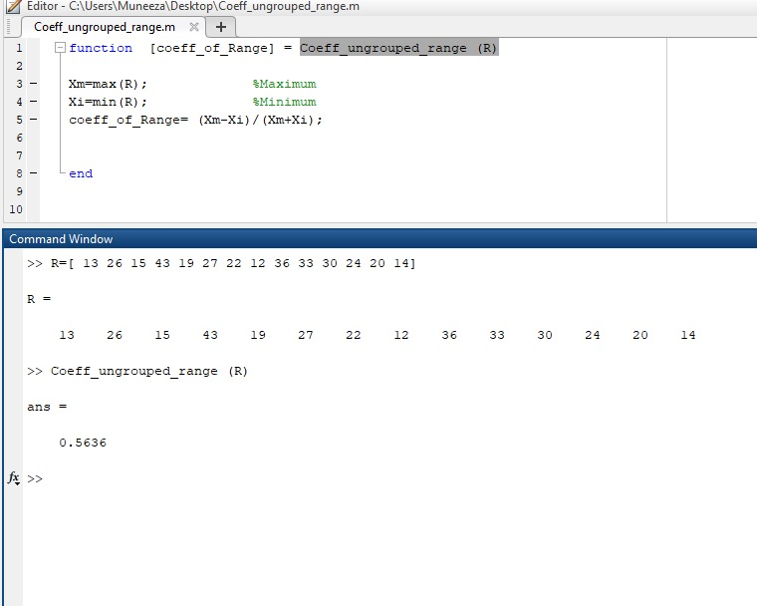
Output of coefficient Range (UG)

Slide 12
Grouped Coefficient of Range
Compute the Coefficient of range of the following data .

Slide 13
Function
function [] = Coeff_Grouped_Range(L, U)
If (U(1)~=L(2))
U = U+0.5; % Upper class boundary
L = L-0.5; % Lower class boundary
end
Xm = max(U); % Maximum Range
Xi = min(L); %Minimum range
coeff_Range = (Xm-Xi)/(Xm+Xi);
end

Slide 14
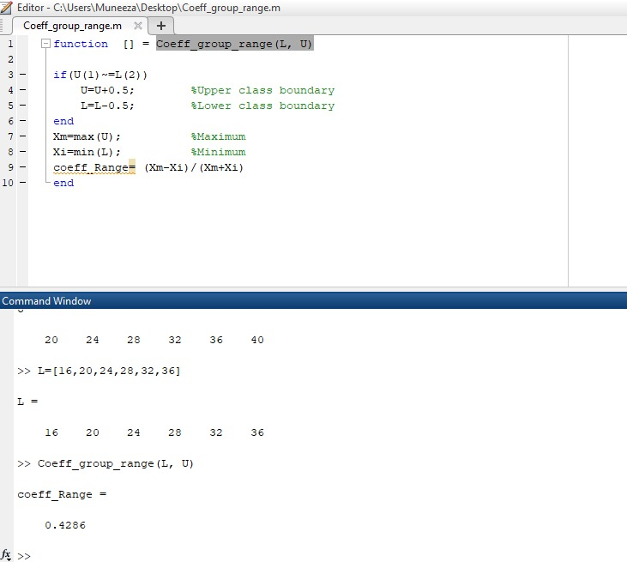
Output of coefficient Range

Slide 15
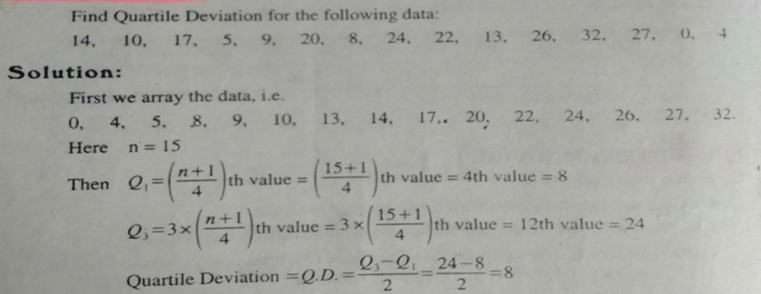
Quartile Deviation(or semi interquartile Range)
Compute the Quartile Deviation of the following data

Slide 16
Function
function[QD] = Quartile_Deviation(F)
f = sort(F);
n = length(F);
nth_value = (n+1)/4;
Q1 = f(nth_value);
nth_value = 3*(n+1)/4;
Q3 = f(nth_value);
QD = (Q3 - Q1)/2;
end

Slide 17
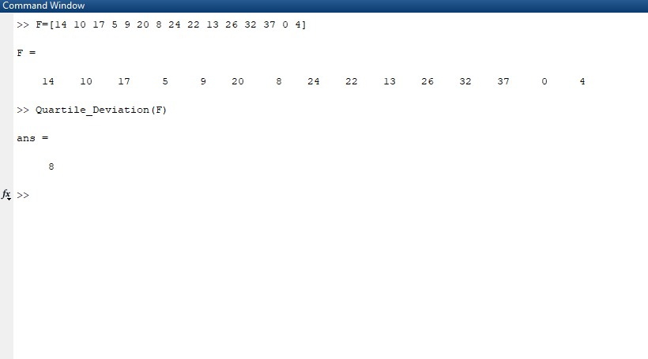
Output of Quartile Deviation (UG)

Slide 18
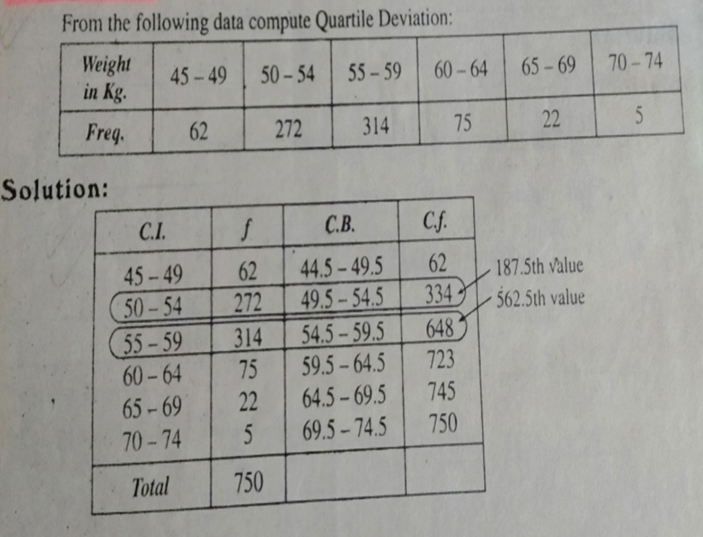
Grouped Quartile Deviation
Compute the Quartile Deviation of the following data

Slide 19
Grouped Function
function[QD] = Grouped_QD(L, U, F)
sum_F = sum(F);
C.F = cumsum(F);
nth_value = (sum_F)/4;
i = 1;
cum_freq = 0;
while(i <= length(C.F))
if(nth_value > C.F(i) && nth_value < C.F(i+1))
cum_freq = C.F(i);
break
end
i = i+1;
end
if(U(i)==L(i+1))
l = L(i+1);
end
if(U(i)~=L(i+1))
l = L(i+1)-0.5;
end
h = (U(i)-L(i))+1;
f = F(i+1);
Q1 = l + h*(nth_value - cum_freq)/f;

Slide 20
nth_value = (3*sum_F)/4;
i = 1;
cum_freq = 0;
while(i <= length(C.F))
if(nth_value > C.F(i) && nth_value < C.F(i+1))
cum_freq = C.F(i);
break
end
i = i+1;
end
if(U(i)==L(i+1))
l = L(i+1);
end
if(U(i)~=L(i+1))
l = L(i+1)-0.5;
end
h = (U(i)-L(i))+1;
f = F(i+1);
Q3 = l + h*(nth_value - cum_freq)/f;
QD = (Q3 - Q1)/2;
end

Slide 21
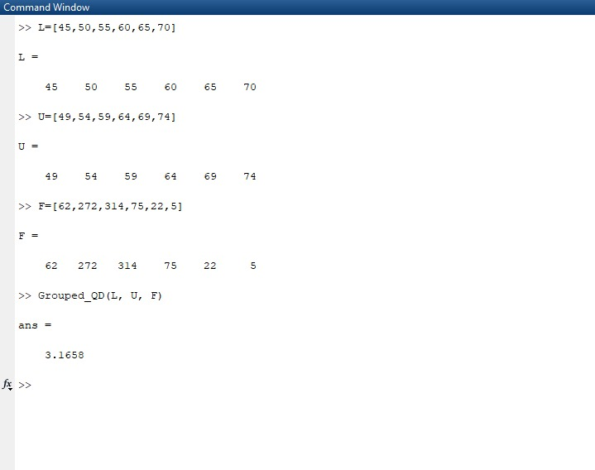
Output of Grouped Quartile Deviation

Slide 22
Coefficient of Quartile Deviation(UG)
Compute the Coefficient Quartile Deviation of the following data

Slide 23
Function
function[coeff_QD] = coeff_QD(F)
f = sort(F);
n = length(F);
nth_value = (n+1)/4;
if(floor(nth_value)==nth_value)
Q1=f(nth_value);
elseif(floor(nth_value)~=nth_value)
b = nth_value - floor(nth_value);
nth_value = floor(nth_value)+ (b*((floor(nth_value)+1) - floor(nth_value)));
Q1=f(floor(nth_value)) + (b*((f(floor(nth_value)+1) - f(floor(nth_value)))));
end
nth_value = 3*(n+1)/4;
if(floor(nth_value)==nth_value)
Q3=f(nth_value);
elseif(floor(nth_value)~=nth_value)
b = nth_value - floor(nth_value);
nth_value = floor(nth_value)+ (b*((floor(nth_value)+1) - floor(nth_value)));
Q3=f(floor(nth_value)) + (b*((f(floor(nth_value)+1) - f(floor(nth_value)))));
end
coeff_QD = (Q3 - Q1)/(Q3 + Q1)
end

Slide 24
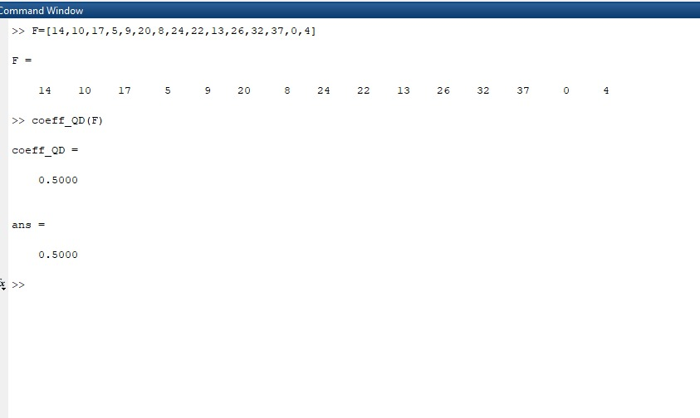
Output of Co-efficient of Quartile Deviation (UG)

Slide 25
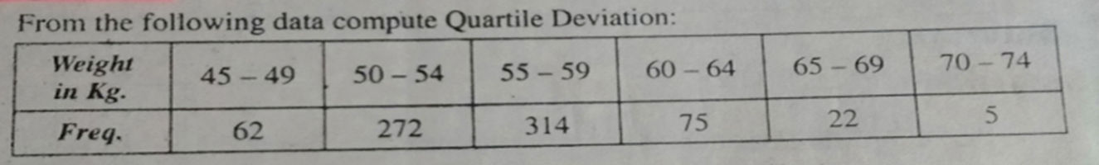
Grouped Co-efficient of Quartile Deviation
Compute the Coefficient Quartile Deviation of the following data

Slide 26
Grouped Function
function[coeff_QD] = coeff_GQD(L, U, F)
sum_F = sum(F);
C.F = cumsum(F);
nth_value = (sum_F)/4;
i = 1;
cum_freq = 0;
while(i <= length(C.F))
if(nth_value > C.F(i) && nth_value < C.F(i+1))
cum_freq = C.F(i);
break
end
i = i+1;
end
if(U(i)==L(i+1))
l = L(i+1);
end
if(U(i)~=L(i+1))
l = L(i+1)-0.5;
end
h = (U(i)-L(i))+1;
f = F(i+1);
Q1 = l + h*(nth_value - cum_freq)/f;
nth_value = (3*sum_F)/4;
i = 1;

Slide 27
cum_freq = 0;
while(i <= length(C.F))
if(nth_value > C.F(i) && nth_value < C.F(i+1))
cum_freq = C.F(i);
break
end
i = i+1;
end
if(U(i)==L(i+1))
l = L(i+1);
end
if(U(i)~=L(i+1))
l = L(i+1)-0.5;
end
h = (U(i)-L(i))+1;
f = F(i+1);
Q3 = l + h*(nth_value - cum_freq)/f;
coeff_QD = (Q3 - Q1)/(Q3 + Q1);
end

Slide 28
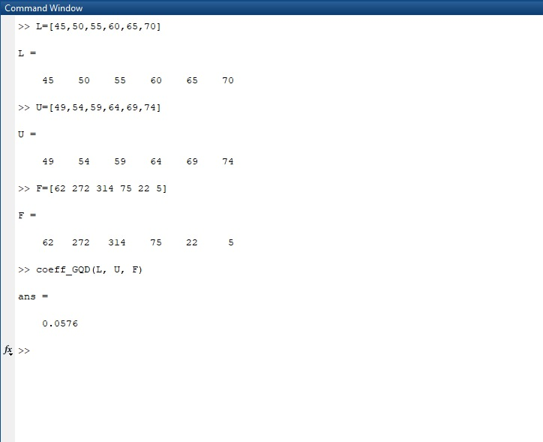
Output of Grouped Coefficient Quartile Deviation (G)

